Slide 1


COMPUTER SCIENCE
S E D G E W I C K / W A Y N E
PA R T I : P R O G R A M M I N G I N JAVA
_{C}omputer
9. Creating Data Types
_{S}cience
An Interdisciplinary Approach
Section 3.2
R O B E R T S E D G E W I C K
KEVIN W A YNE
http:// introcs.cs.princeton.edu

Slide 2

COMPUTER SCIENCE
S E D G E W I C K / W A Y N E
PA R T I : P R O G R A M M I N G I N JAVA
Creating Data Types
Overview
Point charges
Turtle graphics
Complex numbers
CS.9.A.CreatingDTs.Overview

Slide 3

Basic building blocks for programming
any program you might want to write
objects
functions and modules
graphics, sound, and image I/O
arrays
conditionals and loops
Ability to bring life to your own abstractions
Math
text I/O
primitive data types
assignment statements

Slide 4


Object-oriented programming (OOP)
Object-oriented programming (OOP).
Create your own data types.
Use them in your programs (manipulate objects).
An object holds a data type value. Variable names refer to objects.
Examples
data type | set of values | examples of operations
Color | three 8-bit integers | get red component, brighten
Picture | 2D array of colors | get/set color of pixel
String | sequence of characters | length, substring, compare
C | A | T | A | G | C | G | C
An abstract data type is a data type whose representation is hidden from the client.
Impact: We can use ADTs without knowing implementation details.
Previous lecture: how to write client programs for several useful ADTs
This lecture: how to implement your own ADTs

Slide 5

Implementing a data type
To create a data type, you need provide code that
Defines the set of values (instance variables).
Implements operations on those values (methods).
Creates and initialize new objects (constructors).
In Java, a data-type implementation is known as a class.
A Java class
Instance variables
Declarations associate variable names with types.
Set of type values is "set of values".
instance variables
constructors
methods
test client
Methods
Like static methods.
Can refer to instance variables.
Constructors
Like a method with the same name as the type.
No return type declaration.
Invoked by new, returns object of the type.

Slide 6

Anatomy of a Class
text file named
Charge.java
public class Charge
{
private final double rx, ry; // position private final double q; // charge value
instance variables
public Charge(double x0, double y0, double q0)
{
rx = x0; ry = y0; q = q0;
}
constructor
public double potentialAt(double x, double y) { double k = 8.99e09; double dx = x - rx; double dy = y - ry; return k * q / Math.sqrt(dx*dx + dy*dy); } public String toString() { return q + " at " + "(" + rx + ", " + ry + ")"; }
public static void main(String[] args)
{
Charge c = new Charge(.72, .31, 21.3);
StdOut.println(c);
StdOut.printf("%6.2e\n", c.potentialAt(.42, | .71));
}
not “static”
methods
static method (familiar)
test client
% java Charge
21.3 at (0.72, 0.31)
3.61e+11
}

Slide 7
COMPUTER SCIENCE
S E D G E W I C K / W A Y N E
PA R T I : P R O G R A M M I N G I N JAVA
CS.9.A.CreatingDTs.Overview

Slide 8
COMPUTER SCIENCE
S E D G E W I C K / W A Y N E
PA R T I : P R O G R A M M I N G I N JAVA
Creating Data Types
Overview
Point charges
Turtle graphics
Complex numbers
CS.9.B.CreatingDTs.Charges

Slide 9

ADT for point charges
A point charge is an idealized model of a particle that has an electric charge.
An ADT allows us to write Java programs that manipulate point charges.
 | examples
position (x, y ) | (.53, .63) | (.13, .94)
electrical charge | 20.1 | 81.9
Values
public class Charge
Charge(double x0, double y0, double q0)
double potentialAt(double x, double y) | electric potential at (x, y) due to charge
String toString() | string representation of this charge
API (operations)

Slide 10
Crash course on electric potential
Electric potential is a measure of the effect of a point charge on its surroundings.
It increases in proportion to the charge value.
It decreases in proportion to the inverse of the distance from the charge (2D).
Mathematically,
Suppose a point charge c is located at (rx, ry ) and has charge q.
Let r be the distance between (x, y ) and (rx, ry )
Let Vc (x,y ) be the potential at (x, y ) due to c.
(x, y )
r
(rx, ry )
Then
V_{c}(x, y)= k^{q}
where k = 8.99×10⁹ is a normalizing factor.
r
Q. What happens when multiple charges are present?
A. The potential at a point is the sum of the potentials due to the individual charges.
Note: Similar laws hold in many other situations.
Example. N-body (3D) is an inverse square law.

Slide 11


Point charge implementation: Test client
Best practice. Begin by implementing a simple test client.
instance variables
constructors
methods
test client
public static void main(String[] args)
{
Charge c = new Charge(.72, .31, 20.1);
StdOut.println(c); Reminder: automatically invokes c.toString()
StdOut.printf("%6.2e\n", c.potentialAt(.42, .71));
}
(.42, . 71)
.5
(.72, . 31)
r = ^{i}(r_{x} - x)² + (r_{y} - y)²
V_{c}(x, y)= k^{q}
= ✓.3² + .4² = .5
r
₉ 20.1
V_{c}(..42, ..71) = 8.99 X 10
.5
= 3.6
₁₀11
% java Charge
20.1 at (0.72, 0.31)
3.61e+11
What we expect, once the implementation is done.

Slide 12
Point charge implementation: Instance variables
Instance variables define data-type values.
instance variables
constructors
 | examples
position (x, y ) | (.53, .63) | (.13, .94)
electrical charge | 20.1 | 81.9
methods
Values
test client
public class Charge
{
private final double rx, ry; private final double q;
...
}
Modifiers control access.
private denies clients access and therefore makes data type abstract.
final disallows any change in value and documents that data type is immutable.
stay tuned
Key to OOP. Each object has instance-variable values.

Slide 13


Point charge implementation: Constructor
Constructors create and initialize new objects.
instance variables
constructors
methods
test client
public class Charge
{
...
public Charge(double x0, double y0, double q0)
{
references to instance variables, which
rx = x0; ry = y0; q = q0;
are not declared within the constructor
}
...
}
Clients use new to invoke constructors.
Pass arguments as in a method call.
Return value is reference to new object.
Possible memory representation of
Charge c = new Charge(.72, .31, 20.1);
c
x
x
.72
.31
20.1
a memory address

Slide 14



Point charge implementation: Methods
Methods define data-type operations (implement APIs).
instance variables
constructors
methods
test client
public class Charge
Charge(double x0, double y0, double q0)
double potentialAt(double x, double y) | electric potential at (x, y) due to charge
String toString() | string representation of this charge
API
public class Charge
{
...
public double potentialAt(double x, double y)
{
Key to OOP. An instance variable
double k = 8.99e09; double dx = x - rx; double dy = y - ry;
q
reference in an instance method
V_{c}(x, y)= k _{r}
refers to the value for the object
return k * q / Math.sqrt(dx*dx + dy*dy);
that was used to invoke the method.
}
public String toString()
{ return q + " at " + "(" + rx + ", " + ry + ")"; }
...
}
14

Slide 15

Point charge implementation
text file named
Charge.java
public class Charge
{
private final double rx, ry; // position private final double q; // charge value
instance variables
public Charge(double x0, double y0, double q0)
{
rx = x0; ry = y0; q = q0;
}
constructor
public double potentialAt(double x, double y) { double k = 8.99e09; double dx = x - rx; double dy = y - ry; return k * q / Math.sqrt(dx*dx + dy*dy); } public String toString() { return q + " at " + "(" + rx + ", " + ry + ")"; }
public static void main(String[] args)
{
Charge c = new Charge(.72, .31, 20.1);
StdOut.println(c);
StdOut.printf("%6.2e\n", c.potentialAt(.42, | .71));
}
methods
test client
% java Charge
20.1 at (0.72, 0.31)
3.61e+11
}

Slide 16
Point charge client: Potential visualization (helper methods)
Read point charges from StdIn.
Uses Charge like any other type.
Returns an array of Charges.
Convert potential values to a color.
Convert V to an 8-bit integer.
Use grayscale.
public static Charge[] readCharges()
{
int N = StdIn.readInt(); Charge[] a = new Charge[N]; for (int i = 0; i < N; i++)
{
double x0 = StdIn.readDouble(); double y0 = StdIn.readDouble(); double q0 = StdIn.readDouble(); a[i] = new Charge(x0, y0, q0);
}
return a;
}
public static Color toColor(double V)
{
V = 128 + V / 2.0e10;
int t = 0;
if (V > 255) t = 255;
else if (V >= 0) t = (int) V; return new Color(t, t, t);
}
V
t | 0 | 1 | ... | 37 | 38 | 39 | ... | 128 | ... | 254 | 255

Slide 17

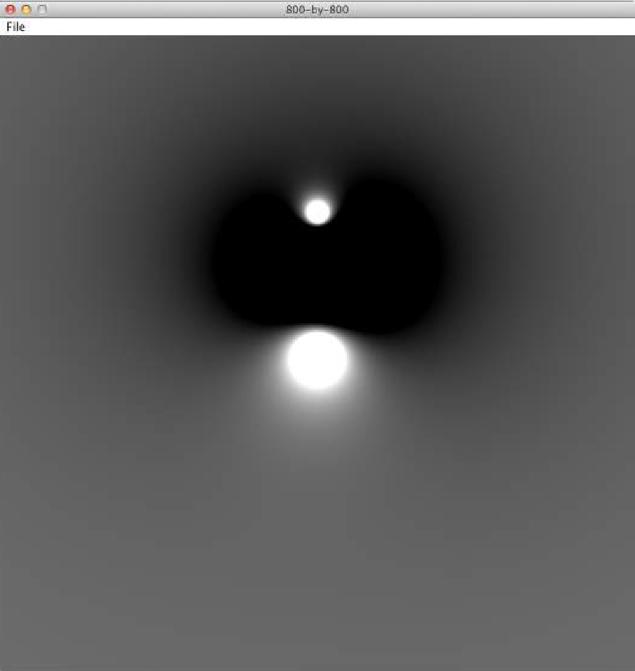
Point charge client: Potential visualization
import java.awt.Color; public class Potential
{
public static Charge[] readCharges()
{ // See previous slide. } public static Color toColor()
{ // See previous slide. }
public static void main(String[] args)
{
Charge[] a = readCharges(); int SIZE = 800;
Picture pic = new Picture(SIZE, SIZE); for (int col = 0; col < SIZE; col++)
for (int row = 0; row < SIZE; row++)
{
double V = 0.0;
for (int k = 0; k < a.length; k++)
{
double x = 1.0 * col / SIZE; double y = 1.0 * row / SIZE;
V += a[k].potentialAt(x, y);
}
pic.set(col, SIZE-1-row, toColor(V));
}
pic.show();
}
}
% more charges3.txt 3
.51 .63 -100
.50 .50 40
.50 .72 20
% java Potential < charges3.txt
17

Slide 18

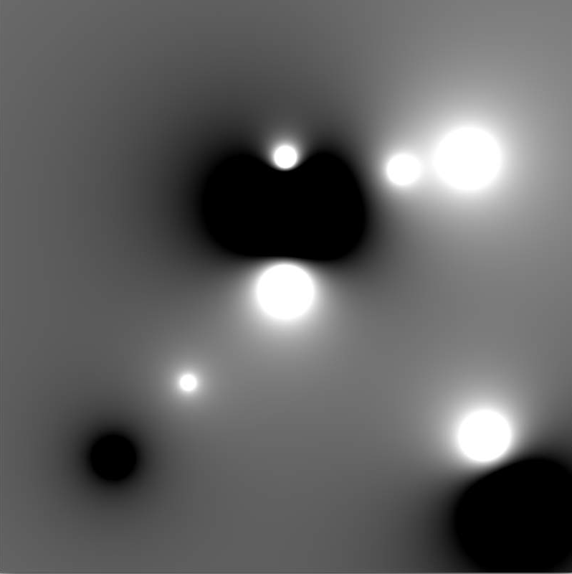
Potential visualization I
% more charges9.txt 9
.51 | .63 | -100
.50 | .50 | 40
.50 | .72 | 20
.33 | .33 | 5
.20 | .20 | -10
.70 | .70 | 10
.82 | .72 | 20
.85 | .23 | 30
.90 | .12 | -50
% java Potential < charges9.txt

Slide 19
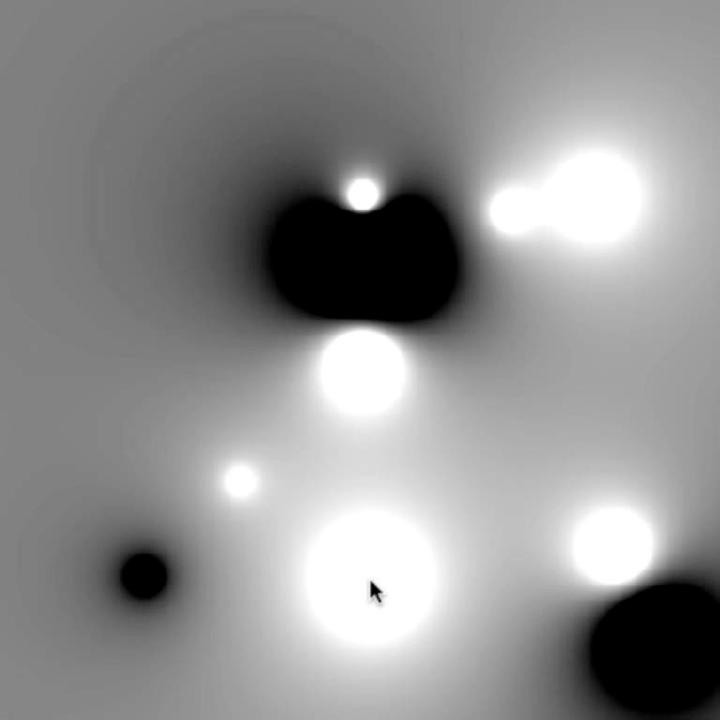

Potential visualization II: A moving charge
% more charges9.txt 9
.51 | .63 | -100
.50 | .50 | 40
.50 | .72 | 20
.33 | .33 | 5
.20 | .20 | -10
.70 | .70 | 10
.82 | .72 | 20
.85 | .23 | 30
.90 | .12 | -50
% java PotentialWithMovingCharge < charges9.txt

Slide 20

Potential visualization III: Discontinuous color map
public static Color toColor(double V)
{
V = 128 + V / 2.0e10;
int t = 0;
if (V > 255) t = 255;
else if (V >= 0) t = (int) V;
return new Color(t, t, t);
}
t = t*37 % 255
V
t | 0 | 1 | 2 | 3 | 4 | 5 | 6 | 7 | 8 | 9 | ...

Slide 21
COMPUTER SCIENCE
S E D G E W I C K / W A Y N E
PA R T I : P R O G R A M M I N G I N JAVA
CS.9.B.CreatingDTs.Charges

Slide 22
COMPUTER SCIENCE
S E D G E W I C K / W A Y N E
PA R T I : P R O G R A M M I N G I N JAVA
Creating Data Types
Overview
Point charges
Turtle graphics
Complex numbers
CS.9.C.CreatingDTs.Turtles

Slide 23

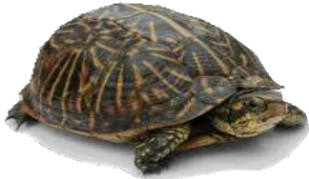


ADT for turtle graphics
A turtle is an idealized model of a plotting device.
An ADT allows us to write Java programs that manipulate turtles.
position (x, y ) | (.5, .5) | (.25, .75) | (.22, .12)
orientation | 90° | 135° | 10°
Seymour Papert 1928−
Values
public class Turtle
Turtle(double x0, double y0, double q0)
void turnLeft(double delta) | rotate delta degrees counterclockwise
void goForward(double step) | move distance step, drawing a line
API (operations)

Slide 24


Turtle graphics implementation: Test client
Best practice. Begin by implementing a simple test client.
instance variables
constructors
methods
test client
public static void main(String[] args)
{
Turtle turtle = new Turtle(0.0, 0.0, 0.0); turtle.goForward(1.0); turtle.turnLeft(120.0); turtle.goForward(1.0); turtle.turnLeft(120.0); turtle.goForward(1.0); turtle.turnLeft(120.0);
}
% java Turtle
Note: Client drew triangle without computing √3
What we expect, once the implementation is done.

Slide 25
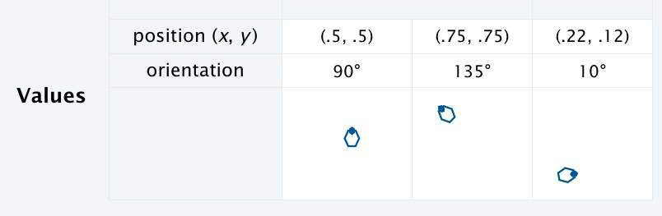
Turtle implementation: Instance variables and constructor
Instance variables define data-type values.
instance variables
constructor
methods
test client
Constructors create and initialize new objects.
public class Turtle
{
private double x, y; private double angle;
instance variables are not final
public Turtle(double x0, double y0, double a0)
{
x = x0; y = y0;
angle = a0;
}
...
}

Slide 26
Turtle implementation: Methods
Methods define data-type operations (implement APIs).
instance variables
constructors
methods
public class Turtle
{
...
public void turnLeft(double delta)
{ angle += delta; }
public void goForward(double d)
{
double oldx = x; double oldy = y;
x += d * Math.cos(Math.toRadians(angle)); y += d * Math.sin(Math.toRadians(angle)); StdDraw.line(oldx, oldy, x, y);
}
...
}
test client
API
public class Turtle
Turtle(double x0, double y0, double q0)
void turnLeft(double delta)
void goForward(double step)
(x0 + d cos α, y0 + d sin α)
d sin α
d
α
d cos α
(x0, y0)

Slide 27

Turtle implementation
text file named
Turtle.java
public class Turtle
{
private double x, y; private double angle;
instance variables
public Turtle(double x0, double y0, double a0)
{
x = x0; y = y0;
angle = a0;
}
constructor
public void turnLeft(double delta)
{ angle += delta; }
public void goForward(double d)
{
double oldx = x; double oldy = y;
x += d * Math.cos(Math.toRadians(angle));
y += d * Math.sin(Math.toRadians(angle)); StdDraw.line(oldx, oldy, x, y);
}
methods
% java Turtle
public static void main(String[] args)
{
Turtle turtle = new Turtle(0.0, 0.0, 0.0); turtle.goForward(1.0); turtle.turnLeft(120.0); turtle.goForward(1.0); turtle.turnLeft(120.0); turtle.goForward(1.0); turtle.turnLeft(120.0);
}
test client
}

Slide 28

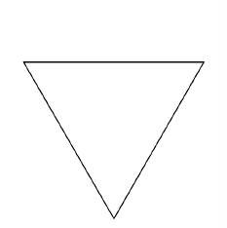




Turtle client: N-gon
% java Ngon 3
public class Ngon
{
public static void main(String[] args)
{
int N = Integer.parseInt(args[0]); double angle = 360.0 / N;
double step = Math.sin(Math.toRadians(angle/2.0)); Turtle turtle = new Turtle(0.5, 0, angle/2.0);
for (int i = 0; i < N; i++)
{
turtle.goForward(step); turtle.turnLeft(angle);
}
}
}
% java Ngon 7
% java Ngon 1440

Slide 29



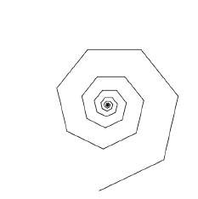

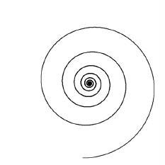
Turtle client: Spira Mirabilis
% java Spiral 3 1.2
public class Spiral
{
public static void main(String[] args)
{
int N = Integer.parseInt(args[0]); double decay = Double.parseDouble(args[1]); double angle = 360.0 / N;
double step = Math.sin(Math.toRadians(angle/2.0));
% java Spiral 7 1.2
Turtle turtle = new Turtle(0.5, 0, angle/2.0); for (int i = 0; i < 10 * N; i++)
{
step /= decay; turtle.goForward(step); turtle.turnLeft(angle);
}
% java Spiral 1440 1.0004
}
}

Slide 30



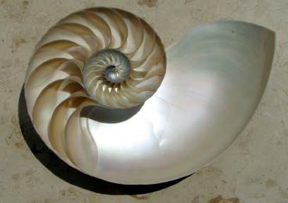


Spira Mirabilis in the wild

Slide 31

Pop quiz 1 on OOP
Q. Fix the serious bug in this code:
public class Turtle
{
private double x, y; private double angle;
public Turtle(double x0, double y0, double a0)
{
double x = x0; double y = y0; double angle = a0;
}
...
}

Slide 32
Pop quiz 1 on OOP
Q. Fix the serious bug in this code:
public class Turtle
{
private double x, y; private double angle;
public Turtle(double x0, double y0, double a0)
{
double x = x0; double y = y0; double angle = a0;
}
...
}
A. Remove type declarations.
They create local variables, which are different from the instance variables!
Object-oriented programmers pledge. "I will not shadow instance variables"
Every programmer makes this mistake, and it is a difficult one to detect.

Slide 33
COMPUTER SCIENCE
S E D G E W I C K / W A Y N E
PA R T I : P R O G R A M M I N G I N JAVA
Image sources
http://web.media.mit.edu/~papert/ http://en.wikipedia.org/wiki/Logarithmic_spiral
http://en.wikipedia.org/wiki/Logarithmic_spiral#/media/File:Nautilus_Cutaway_with_Logarithmic_Spiral.png http://en.wikipedia.org/wiki/File:Low_pressure_system_over_Iceland.jpg
CS.9.C.CreatingDTs.Turtles

Slide 34
COMPUTER SCIENCE
S E D G E W I C K / W A Y N E
PA R T I : P R O G R A M M I N G I N JAVA
Creating Data Types
Overview
Point charges
Turtle graphics
Complex numbers
CS.9.D.CreatingDTs.Mandelbrot

Slide 35
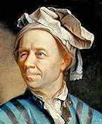
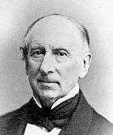
Crash course in complex numbers
A complex number is a number of the form a + bi where a and b are real and i ✓-1 .
Complex numbers are a quintessential mathematical abstraction that have been used for centuries to give insight into real-world problems not easily addressed otherwise.
To perform algebraic operations on complex numbers, use real algebra, replace i ² by −1 and collect terms.
Addition example: (3 + 4i ) + (−2 + 3i ) = 1 + 7i .
Multiplication example: (3 + 4i ) x (−2 + 3i ) = −18 + i .
Leonhard Euler 1707−1783
A. L. Cauchy 1789−1857
Example: | 3 + 4i | = 5
The magnitude or absolute value of a complex number a + bi is |a + bi| = /a² + b² .
Applications: Signal processing, control theory, quantum mechanics, analysis of algorithms...

Slide 36
ADT for complex numbers
A complex number is a number of the form a + bi where a and b are real and i ✓-1 .
An ADT allows us to write Java programs that manipulate complex numbers.
complex number | 3 + 4i | −2 + 2i
real part | 3.0 | −2.0
imaginary part | 4.0 | 2.0
Values
public class Complex
Complex(double real, double imag)
Complex plus(Complex b) | sum of this number and b
Complex times(Complex b) | product of this number and b
double abs() | magnitude
String toString() | string representation
API (operations)

Slide 37

Complex number data type implementation: Test client
Best practice. Begin by implementing a simple test client.
instance variables
constructors
methods
test client
public static void main(String[] args)
{
Complex a = new Complex( 3.0, 4.0); Complex b = new Complex(-2.0, 3.0); StdOut.println("a = " + a); StdOut.println("b = " + b); StdOut.println("a * b = " + a.times(b));
}
% java Complex
a = 3.0 + 4.0i
b = -2.0 + 3.0i
a * b = -18.0 + 1.0i
What we expect, once the implementation is done.

Slide 38
Complex number data type implementation: Instance variables and constructor
Instance variables define data-type values.
instance variables
constructor
methods
test client
Constructors create and initialize new objects.
public class Complex
{
private final double re; private final double im;
instance variables
are final
public Complex(double real, double imag)
{
re = real; im = imag;
}
...
}
complex number | 3 + 4i | −2 + 2i
real part | 3.0 | −2.0
imaginary part | 4.0 | 2.0
Values

Slide 39
Complex number data type implementation: Methods
Methods define data-type operations (implement APIs).
instance variables
constructors
methods
test client
public class Complex
{
...
public Complex plus(Complex b)
might also write "this.re"
Java keyword "this" is a
reference to "this object" and is implicit when an instance variable is directly referenced
{
or use Complex a = this
double real = re + b.re; double imag = im + b.im;
a = v + wi
b = x + yi
a x b = vx + vyi + wxi + wyi²
= vx - wy + (vy + wx)i
API
return new Complex(real, imag);
}
public Complex times(Complex b)
{
double real = re * b.re - im * b.im; double imag = re * b.im + im * b.re; return new Complex(real, imag);
}
public double abs()
{ return Math.sqrt(re*re + im*im); }
public String toString()
public class Complex
Complex(double real, double imag)
Complex plus(Complex b) | sum of this number and b
Complex times(Complex b) | product of this number and b
double abs() | magnitude
String toString() | string representation
{ return re + " + " + im + "i"; }
...
}

Slide 40

Complex number data type implementation
text file named
Complex.java
public class Complex
{
private final double re;
private final double im;
instance variables
public Complex(double real, double imag)
{ re = real; im = imag; }
constructor
public Complex plus(Complex b)
{
double real = re + b.re;
double imag = im + b.im;
return new Complex(real, imag);
}
public Complex times(Complex b)
{
double real = re * b.re - im * b.im;
double imag = re * b.im + im * b.re;
return new Complex(real, imag);
}
public double abs()
{ return Math.sqrt(re*re + im*im); }
public String toString()
{ return re + " + " + im + "i"; }
public static void main(String[] args)
{
Complex a = new Complex( 3.0, 4.0);
Complex b = new Complex(-2.0, 3.0);
StdOut.println("a = " + a);
StdOut.println("b = " + b);
StdOut.println("a * b = " + a.times(b));
}
methods
% java Complex
a = 3.0 + 4.0i
b = -2.0 + 3.0i
a * b = -18.0 + 1.0i
test client
}
40

Slide 41



The Mandelbrot set
The Mandelbrot set is a set of complex numbers.
Represent each complex number x + yi by a point (x, y ) in the plane.
If a point is in the set, we color it BLACK.
If a point is not in the set, we color it WHITE.
(1, 1)
B. Mandelbrot 1924−2010
Examples
In the set: −0.5 + 0i.
Not in the set: 1 + i.
Challenge
No simple formula exists for testing whether a number is in the set.
Instead, the set is defined by an algorithm.
(−0.5, 0)

Slide 42
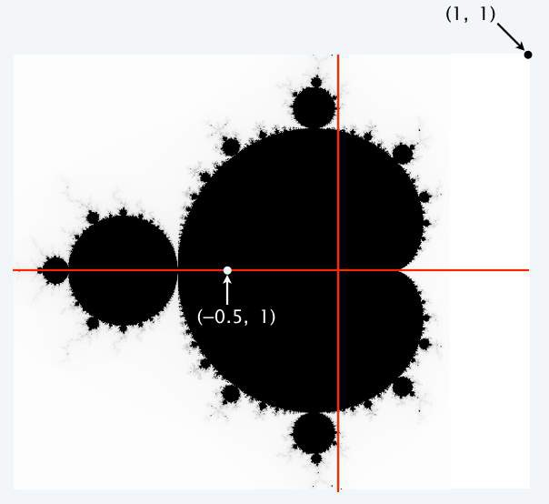
Determining whether a point is in the Mandelbrot set
Is a complex number z0 in the set?
Iterate zt+1 = (zt )² + z0.
If |zt | diverges to infinity, z0 is not in the set.
If not, z0 is in the set.
t | zt
0 | −1/2 + 0i
1 | −1/4 + 0i
2 | −7/16 + 0i
3 | −79/256 + 0i
4 | −26527/65536 + 0i
t | zt
0 | 1 + i
1 | 1 + 3i
2 | −7 + 7i
3 | 1 − 97i
4 | −9407 − 193i
(−0.5, 0)
(1+i )² + (1+i ) = 1 + 2i + i ² + 1 + i = 1+3i
(1+3i )² + (1+i ) = 1 + 6i + 9i ² + 1 + i = −7+7i
always between −1/2 and 0 z = −1/2 + 0i is in the set
diverges to infinity
z = 1 + i is not in the set

Slide 43
Plotting the Mandelbrot set
Practical issues
Cannot plot infinitely many points.
Cannot iterate infinitely many times.
 |  |  |  |  |  |  |  |  |  | (−0. | 5 | , 0)
Approximate solution for first issue
Sample from an N-by-N grid of points in the plane.
Zoom in to see more detail (stay tuned!).
Approximate solution for second issue
Fact: if | zt | > 2 for any t, then z is not in the set.
Pseudo-fact: if | z255 | ≤ 2 then z is "likely" in the set.
Important note: Solutions imply significant computation.

Slide 44
Complex number client: Mandelbrot set visualization (helper method)
Mandelbrot function of a complex number.
Returns WHITE if the number is not in the set.
Returns BLACK if the number is (probably) in the set.
public static Color mand(Complex z0)
{
Complex z = z0;
for (int t = 0; t < 255; t++)
{
if (z.abs() > 2.0) return Color.WHITE; z = z.times(z);
z = z.plus(z0);
}
return Color.BLACK;
}
For a more dramatic picture,
return new Color(255-t, 255-t, 255-t)
or colors picked from a color table.

Slide 45






Complex number client: Mandelbrot set visualization
import java.awt.Color; public class Mandelbrot
{
public static Color mand(Complex z0)
{ // See previous slide. }
public static void main(String[] args)
{
% java Mandelbrot –.5 0 2 32
% java Mandelbrot –.5 0 2 512
% java Mandelbrot –.5 0 2 128
% java Mandelbrot –.5 0 2 256
% java Mandelbrot –.5 0 2 64
double xc double yc
= Double.parseDouble(args[0]);
= Double.parseDouble(args[1]);
double size = Double.parseDouble(args[2]); int N = Integer.parseInt(args[3]); Picture pic = new Picture(N, N);
for (int col = 0; col < N; col++)
for (int row = 0; row < N; row++) ^{scale to screen}
{
coordinates
double x0 = xc - size/2 + size*col/N; double y0 = yc - size/2 + size*row/N; Complex z0 = new Complex(x0, y0); Color color = mand(z0);
pic.set(col, N-1-row, color);
}
pic.show();
}
(0, 0) is upper left corner
}
45

Slide 46



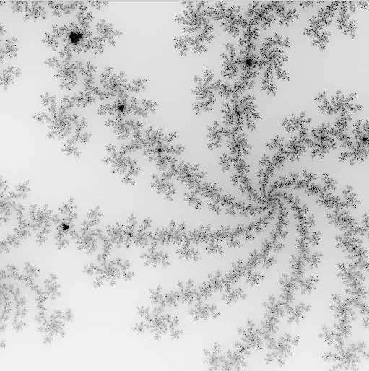

Mandelbrot Set
% java GrayscaleMandelbrot –.5 0 2
% java GrayscaleMandelbrot .1045 -.637 .01

Slide 47






Mandelbrot Set
% java ColorMandelbrot –.5 0 2 < mandel.txt
color map
–1.5 0 2
–1.5 0 .002

Slide 48





Slide 49

Mandelbrot Set
(-1.5, -1)

Slide 50






OOP summary
Object-oriented programming (OOP)
Create your own data types (sets of values and ops on them).
Use them in your programs (manipulate objects).
OOP helps us simulate the physical world
Java objects model real-world objects.
Not always easy to make model reflect reality.
Examples: charged particle, color, sound, genome….
OOP helps us extend the Java language
Java doesn't have a data type for every possible application.
Data types enable us to add our own abstractions.
Examples: complex, vector, polynomial, matrix, picture....
T | A | G | A | T | G | T | G | C | T | A | G | C

Slide 51




You have come a long way
any program you might want to write
objects
public class HelloWorld
{
public static void main(String[] args)
functions and modules
{
System.out.println("Hello, World");
graphics, sound, and image I/O
}
}
arrays
conditionals and loops
Math text I/O
primitive data types assignment statements
T | A | G | A | T | G | T | G | C | T | A | G | C
✓
Course goal. Open a whole new world of opportunity for you (programming).

Slide 52
COMPUTER SCIENCE
S E D G E W I C K / W A Y N E
PA R T I : P R O G R A M M I N G I N JAVA
Image sources
http://en.wikipedia.org/wiki/Leonhard_Euler#/media/File:Leonhard_Euler.jpg http://en.wikipedia.org/wiki/Augustin-Louis_Cauchy http://upload.wikimedia.org/wikipedia/commons/e/e9/Benoit_Mandelbrot_mg_1804-d.jpg http://upload.wikimedia.org/wikipedia/commons/f/fc/Mandel_zoom_08_satellite_antenna.jpg http://upload.wikimedia.org/wikipedia/commons/1/18/Mandelpart2.jpg http://upload.wikimedia.org/wikipedia/commons/f/fb/Mandel_zoom_13_satellite_seehorse_tail_with_julia_island.jpg
http://upload.wikimedia.org/wikipedia/commons/4/44/Mandelbrot_set_à_la_Pop_Art_-_Wacker_Art_Fractal_Generator.jpg
CS.9.D.CreatingDTs.Mandelbrot

Slide 53
COMPUTER SCIENCE
S E D G E W I C K / W A Y N E
PA R T I : P R O G R A M M I N G I N JAVA
_{C}omputer
9. Creating Data Types
_{S}cience
An Interdisciplinary Approach
Section 3.2
R O B E R T S E D G E W I C K
KEVIN W A YNE
http:// introcs.cs.princeton.edu

